Slide 1
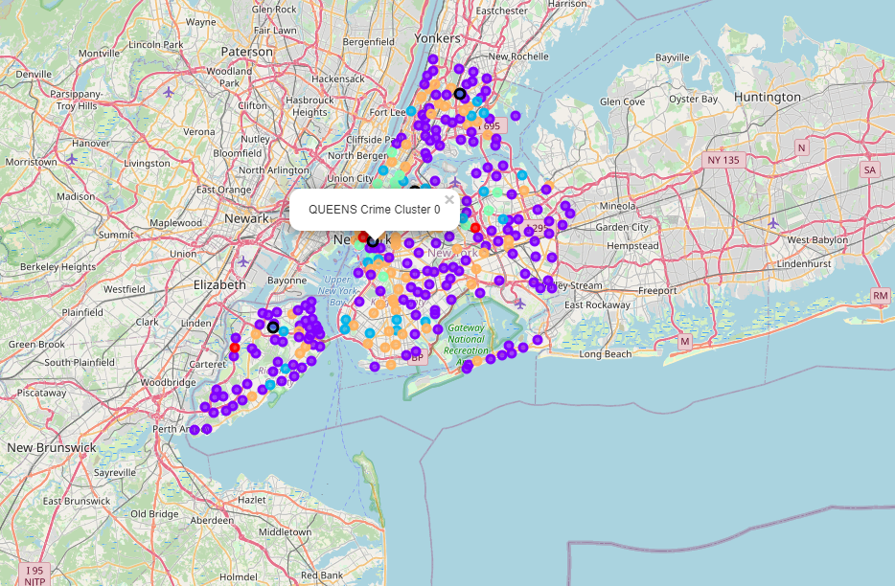
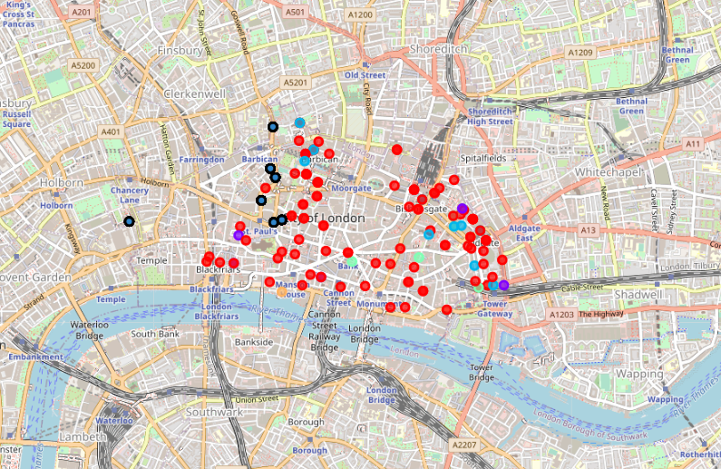
NYC and London Crimes and Health Services
Capstone Project - Data Science Certification

Slide 2

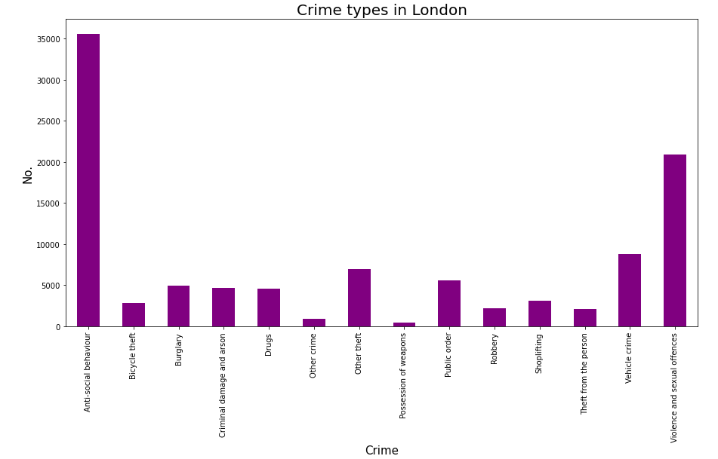
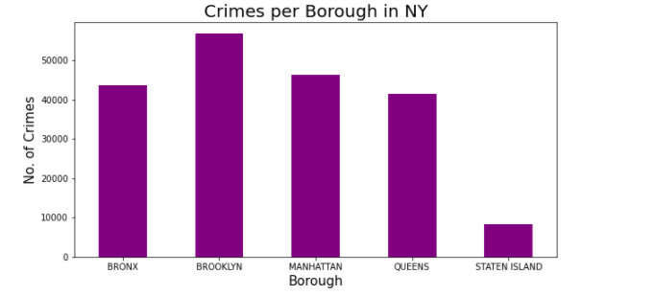
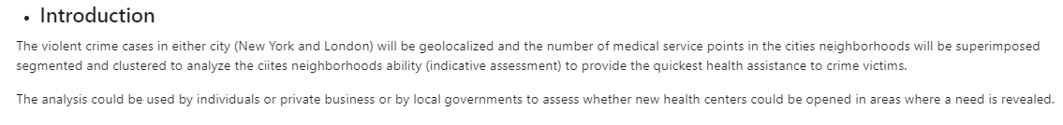
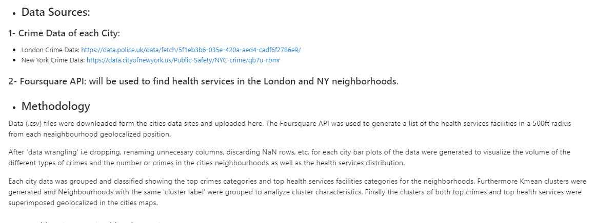

Slide 3
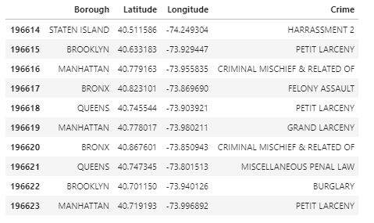
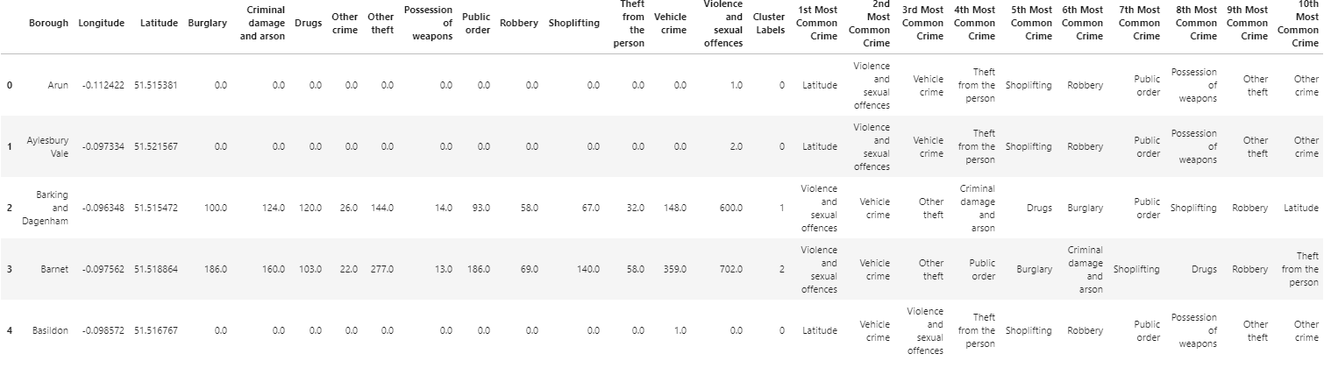
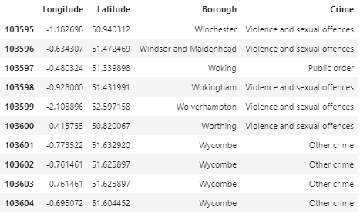
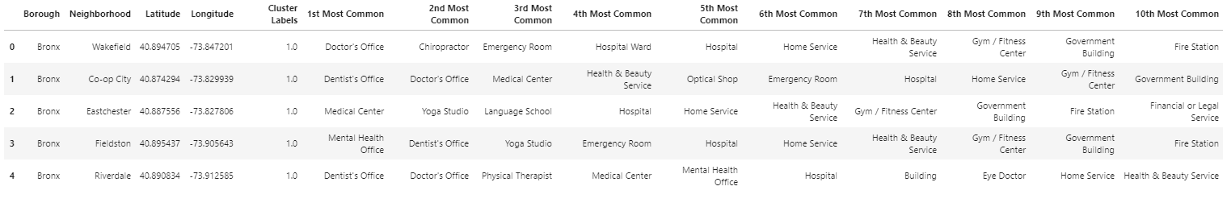
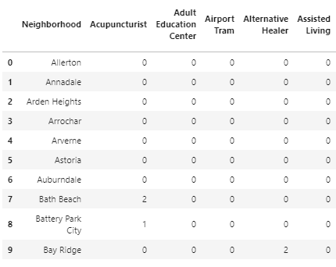
Using the crime data from the cities data and the Foursquare API – Generate Kmean Clusters
NYC Most Common Crimes
NYC Most Common Health Services

Slide 4
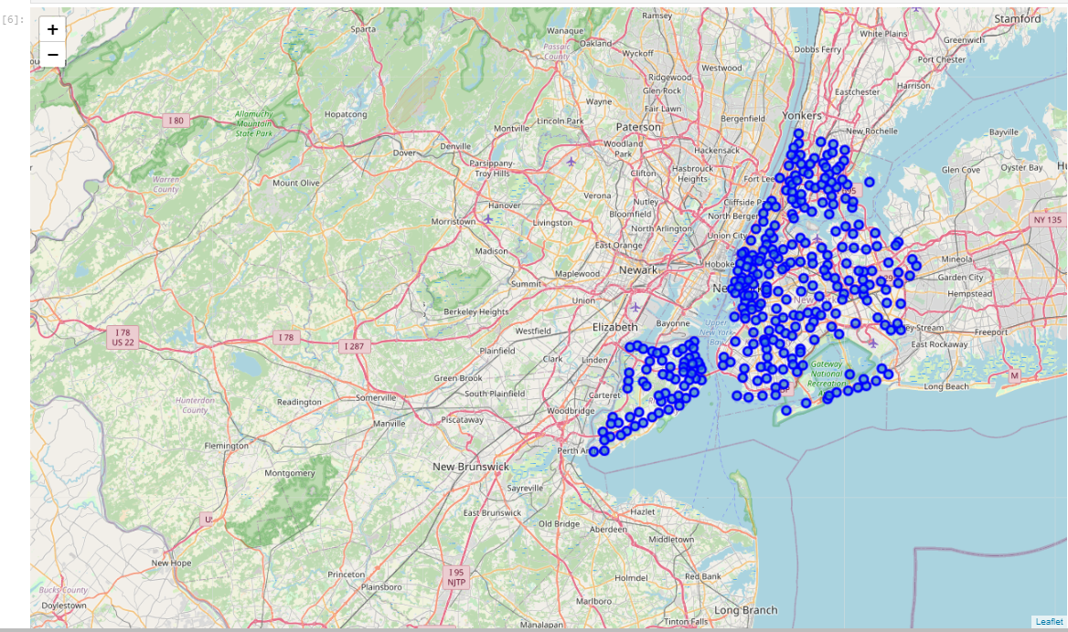
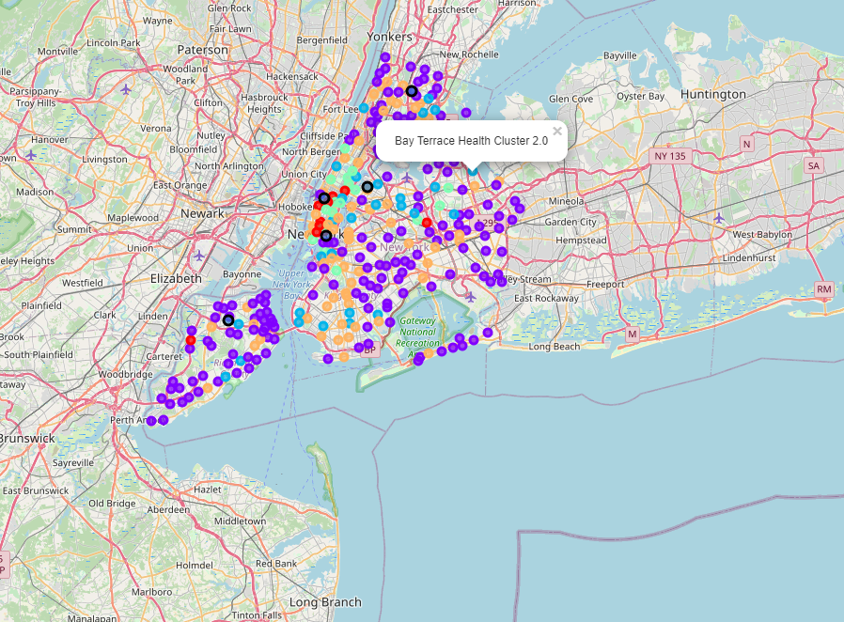
Geolocalized Clusters
‘Crime’ Clusters
Crime and Health Services clusters superimposed in the New York City map
‘Health’ Clusters

Slide 5
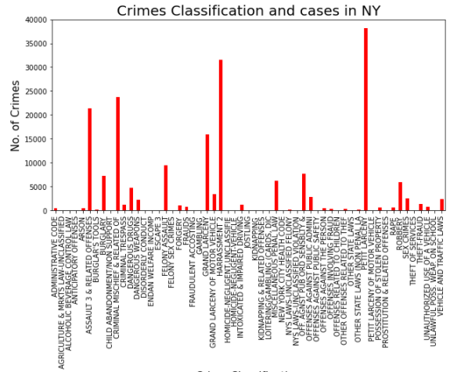
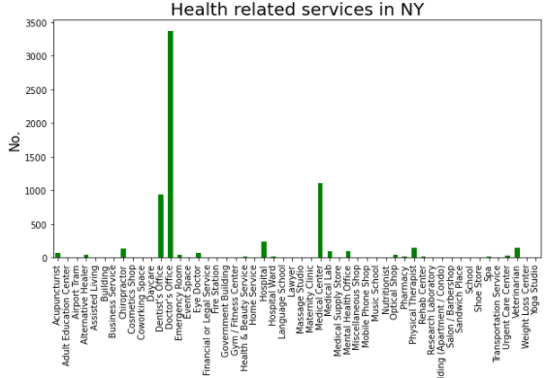
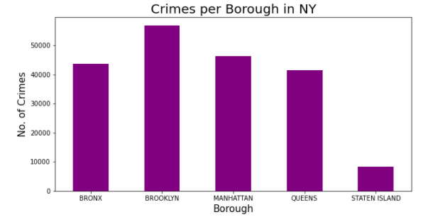
NYC Data Bar Plots
The bar plots for the crime and health services data was used to gain visual insight of the Borough and Neighborhoods trends.

Slide 6
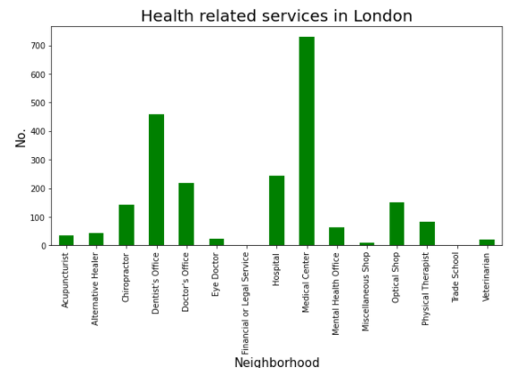
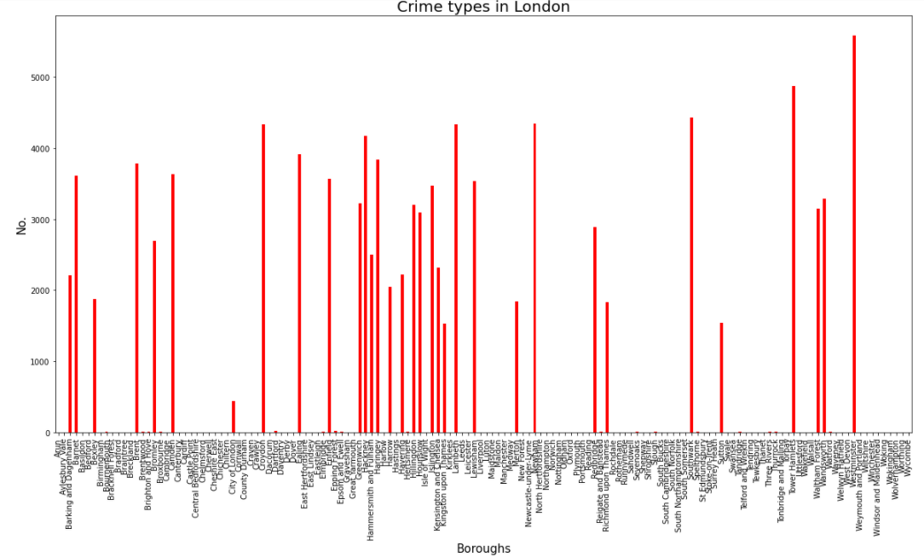
London Data Bar Plots
The bar plots for the crime and health services data was used to gain visual insight of the Borough and Neighborhoods trends.

Slide 7
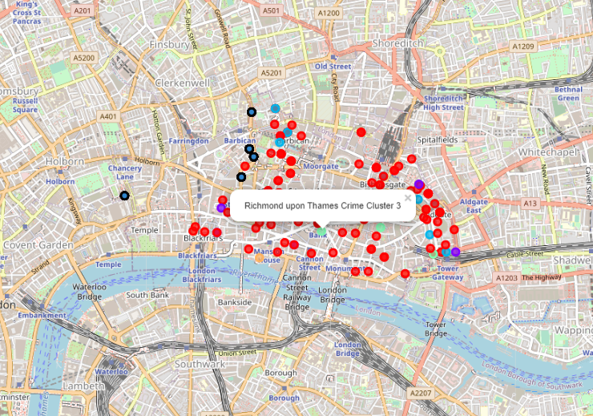
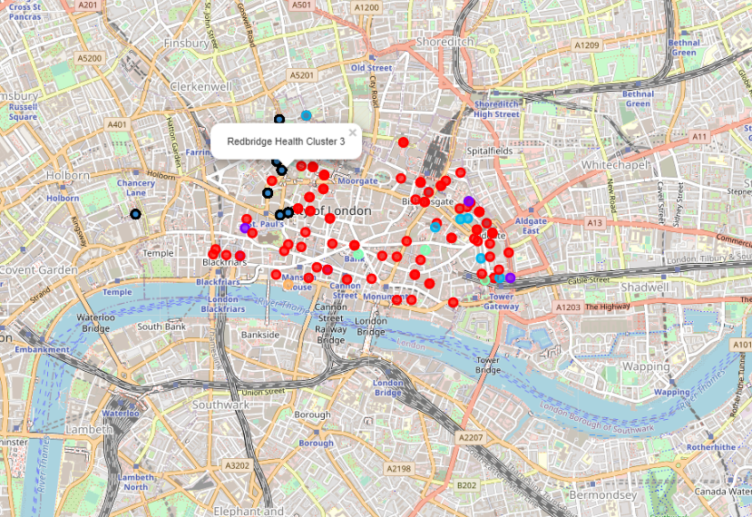
London Crime and Health Clusters
The same methodology used for NYC was applied to London Crime and Health Services data.
The clusters of the most common crime types and the most common health services geolocalized in the London city map

Slide 8
Results & Discussion
NYC appears to have a significantly larger number of violent crime cases than London (3 to 5-fold times) and equivalently the number of available health facilities shows a similar trend. This indicates no major difference in the ability of the city to provide health assistance. A more in-depth analysis but based on neighbourhoods:
For the city of New York: The data indicates that the only based on the number of crimes the most dangerous (violent crimes) neighbourhoods are those of Bronx (Cluster 0) followed by Brooklyn and Manhattan (Cluster 2); Data shows Queens neighborhoods with more available medical services and thus an opportunity specifically for Brooklyn and Manhattan to improve.
For the city of London: The data indicates that the only based on the number of crimes the most dangerous neighbourhoods are those of Westminster followed by Camden and Chelsea; Data shows Westminster neighborhoods with more available medical services and thus an opportunity specifically for Camden and Chelsea.

Slide 9
Conclusions & Recommendations
The goal of this project was to provide private businesses and/or local governments with an indicative assessment of the availability of health services in the neighborhoods of each city to provide assistance to the victims in relation with the number of crimes on each neighborhood. The project has achieved the indicative assessment.
Recommendation: Further analysis based on violent vs non-violent crimes and the health facilities size/capacity to treat victims, etc. would be recommended to get a deeper insight to those planning to make health services investments.

